Slide 1
AWS EC2
BY Rishabh Khanna

Slide 2
EC2 Service Let’s you create virtual machines on AWS
Each machine is called an EC2 instance
EC2 = ECC (Elastic Compute Cloud)
EC2 instance are elastic, meaning they can instantly grow or shrink to match the requirements of a specific application.
You can pay-as-you-go for EC2 instances per second.

Slide 3
Features of Amazon EC2
Persistent storage volume for data using Amazon Elastic block store.
Multiple physical locations for your resources such as instances and Amazon EBS volumes known as regions and Availability Zones.
A firewall that enables you to specify ports, protocols and source IP ranges that can reach your instances. Also called security groups.
Option of having static ipv4 addresses for dynamic cloud computing, known as Elastic IP addresses.
Various sizes and capacity of servers.

Slide 4
In order to create an ec2 instance , we have to have an AMI
AMI Stands for Amazon Machine Image.
AMI is basically an OS image.
An Amazon Machine Image (AMI) provides the information required to launch an instance.
An AMI includes the following:
A template for the root volume for the instance (for example, an operating system, an application server, and applications)
Launch permissions that control which AWS accounts can use the AMI to launch instances.
A block device mapping that specifies the volumes to attach to the instance when it's launched.

Slide 5
Types of AMI:
AWS provided AMI’s (free)
Community AMI’s (free)
AWS marketplace AMI (free and paid)
Your custom AMI’s

Slide 6
Amazon Linux AMI
Features of Amazon Linux AMI’s are:
A stable, secure, and high-performance execution environment for applications running on Amazon EC2.
Provided at no additional charge to Amazon EC2 users.
Repository access to multiple versions of MySQL, PostgreSQL, Python, Ruby, Tomcat, and many more common packages.
Regular updates of components and packages like yum
Includes packages that enable easy integration with AWS services, such as the AWS CLI, the Boto library for Python etc.

Slide 7
You need certain things/components to successfully launch an EC2 and log into it
VPC , Subnet ( there are default subnets)
Security Group
Key Pair
Storage ( usually EBS)
AMI
Instance Type

Slide 8
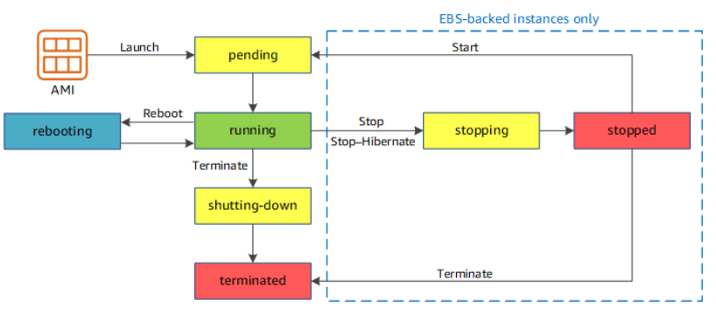
EC2 Lifecycle
You can:
Launch EC2
Reboot/restart
Stop EC2( like shutdown)
Hibernate EC2 instance
Terminate EC2( release forever)
Start EC2( If Stopped)

Slide 9
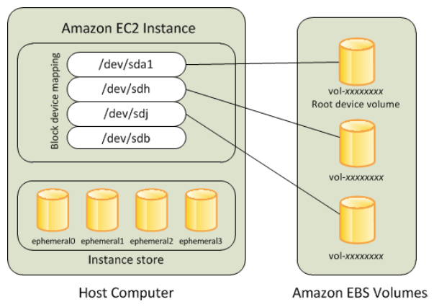
There are 2 kinds of EC2 Storage
Instance Store: Hard disk is in the host machine. You lose data if EC2 instance is shut down.
EBS Storage:
EBS stands for Elastic Block Storage.
EBS one of the two types of storage on AWS.
EBS is basically independent of EC2 and is like a networked drive. You can terminate( release forever) an EC2 and still save EBS volumes and use it later.

Slide 10
EC2 Pricing Model
On Demand Instances : Rent it for few seconds/hours/days etc . Pay as you go
Reserved Instances : Pay upfront for 1-3 years and save a lot ( up to 75%)
Spot Instance: You bid on them IF available. May terminate with 2 minute notice . uptp 90% cheaper than On Demand Instances

Slide 11
When an EC2 instance Is stopped
Private IP remains with the EC2 instance.
Public IP may change when you restart a stopped instance.
The underlying host (physical machine) may change.

Slide 12
EC2 Public IP address and Elastic IP
Elastic IP (EIP) are Static(persistent) IP’s that you can create on demand. They are different than the Public IP you get when you launch an EC2 instance ( if public IP is enabled) . You can attach EIP to an EC2 instance.
Elastic IP’s stay with the instance even when the instance is stopped. This is in contrast to the default Public IP given to instance, which is released after an instance is stopped
You always pay for EIP if it’s not attached to a running EC2. So if EC2 is stopped and has Elastic IP , you pay for the EIP.

Slide 13
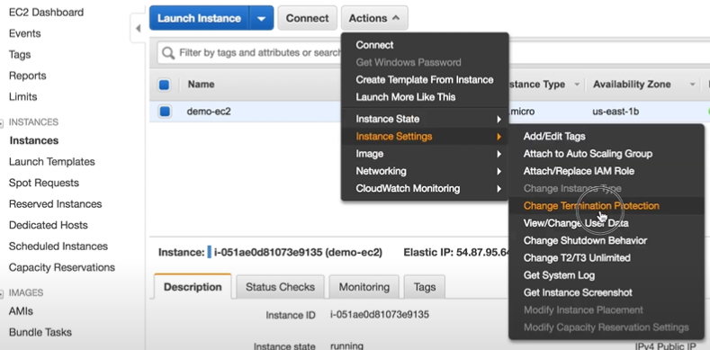
Termination Protection: Easy to launch , easy to destroy
In order to protect accidental deletion, we can set termination protection on an EC2 Instance. This is an added layer of protection for critical EC2 instance.

Slide 14
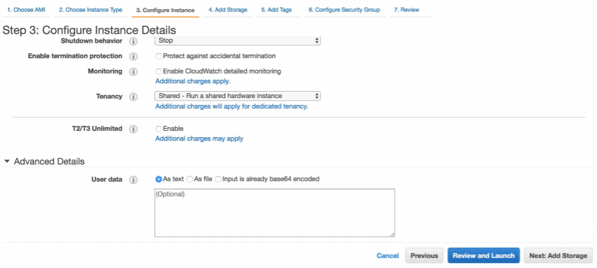
Run Commands on Your EC2 Instance at Launch
You can do this using Userdata section. Just pass a script in the userdata box Tab 3 during the launch process.

Slide 15
Roles: Add permissions to EC2
You can’t access other AWS resources from your EC2 instance by default. You need to either
hard code credentials( access key id and secret access key) somewhere in the code or in a file which is not recommended.
Attach Roles with proper permissions to EC2 . This way you can access services like S3 , dynamoDB etc from EC2 . This is safer because Roles use temporary credentials.

Slide 16
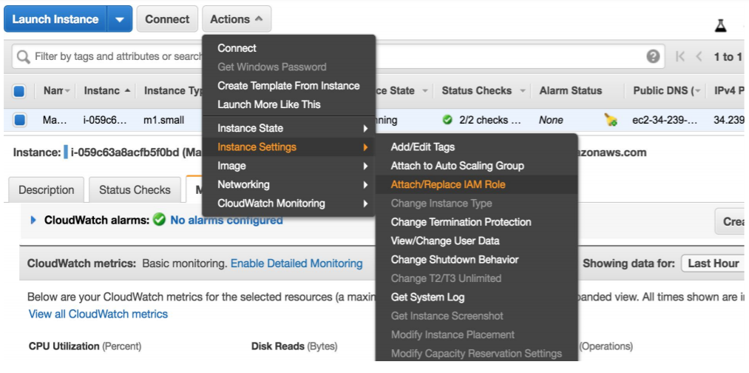

Slide 17
Interfaces to ec2
You can interface with EC2 resources using the following mediums:
AWS Management console
AWS CLI
AWS Cloudformation
AWS SDK(boto,node.js, java etc)
AWS REST API

